Slide 1
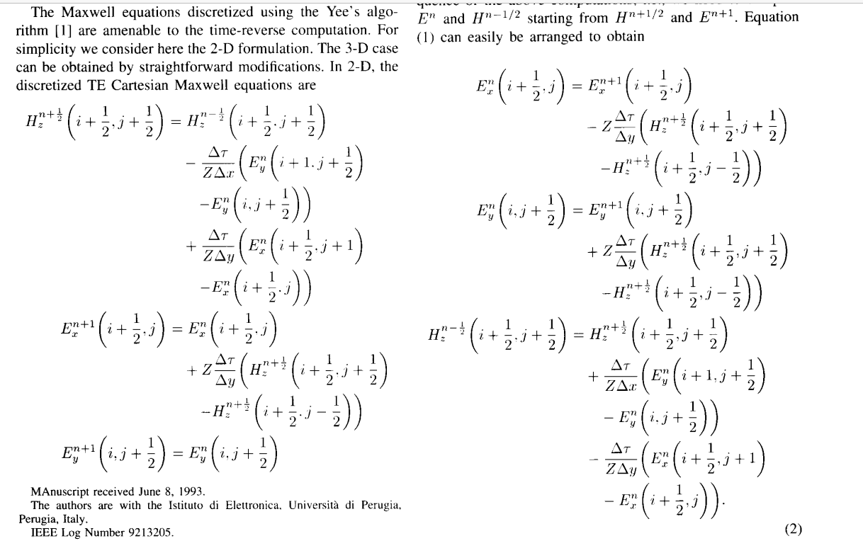
Time Reverse (TR) FDTD- Yizhao Guan

Slide 2
1次元FDTDでTRの検証
Source: E=1のpulse
Boundary: PBC

Slide 3
2次元FDTD (TE mode) でTRの検証
Source: Gaussian pulse
Boundary: PBC
Normal FDTD with source
TR FDTD from final step in left

